Slide 1

Hacking OAuth: An Attacker's View of your OAuth Flows
SK
by Sheshananda Reddy Kandula

Slide 2
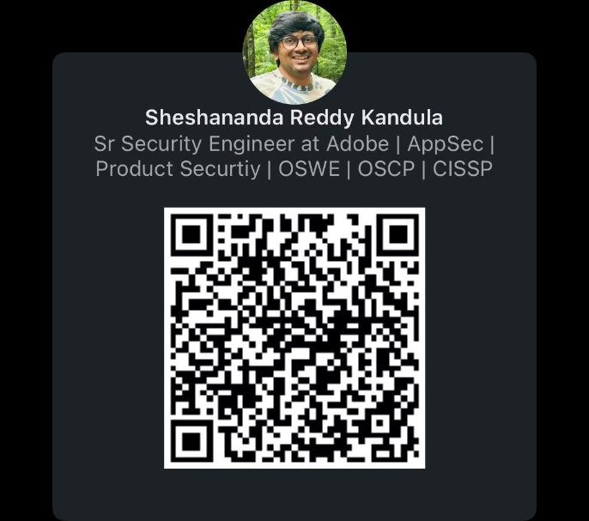
Whoami
@Sheshananda Reddy Kandula
15 years in Application Security
Member of ISC2 NJ Chapter
Notes:
available on LinkedIn/Twitter etc

Slide 3

Whoami
@Sheshananda Reddy Kandula
15 years in Application Security
Member of ISC2 NJ Chapter
Notes:
available on LinkedIn/Twitter etc

Slide 4
Agenda
Introduction - Authentication vs Authorization
OAuth Protocol
How OAuth Works
OAuth Work Flows
OAuth Play Ground
Common OAuth Vulnerabilities

Slide 5
Introduction
Authentication vs Authorization

Slide 6
Authentication
The process of verifying the identity of a user, process, or device, often as a prerequisite to allowing access to resources in an information system.

Slide 7
Authorization
Authorization is the security process that determines a user or service's level of access. In technology, we use authorization to give users or services permission to access some data or perform a particular action.

Slide 8
Authentication vs Authorization
Authentication (from Greek: αὐθεντικός authentikos, "real, genuine", from αὐθέντης authentes, "author") is the act of proving an assertion, such as the identity of a computer system user. In contrast with identification, the act of indicating a person or thing's identity, authentication is the process of verifying that identity.[1][2] It might involve validating personal identity documents, verifying the authenticity of a website with a digital certificate,[3] determining the age of an artifact by carbon dating, or ensuring that a product or document is not counterfeit.
Authorization or authorisation (see spelling differences) is the function of specifying rights/privileges for accessing resources, which is related to general information security and computer security, and to IAM (Identity and Access Management) in particular.[1]

Slide 9
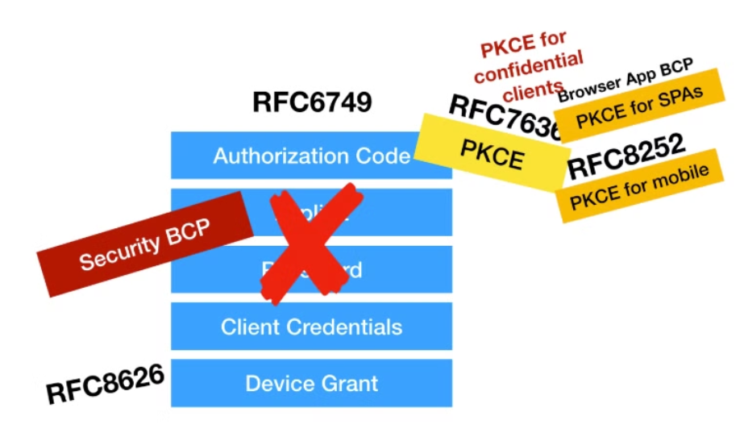
OK. What is OAuth?
OAuth is Open Authorization Protocol
OAuth is Delegated Authorization
OAuth (short for open authorization[1][2]) is an open standard for access delegation, commonly used as a way for internet users to grant websites or applications access to their information on other websites but without giving them the passwords.[3][4] This mechanism is used by companies such as Amazon,[5] Google, Meta Platforms, Microsoft, and Twitter to permit users to share information about their accounts with third-party applications or websites.
It's a Protocol —> RFCs ?
It's Time for OAuth 2.1

Slide 10
Why do we need to share resources securely?
Users would like to share their photos, videos, files, documents with other apps from One App to Another App.
From GDrive to WhatsApp/iMessages
But what if, user data/files are on the Server

Slide 11
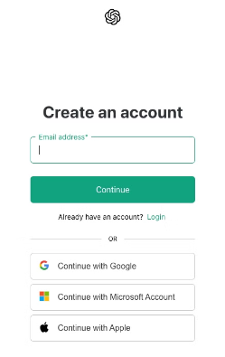
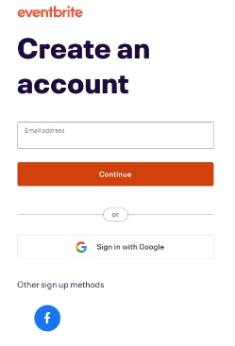
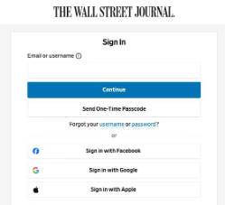
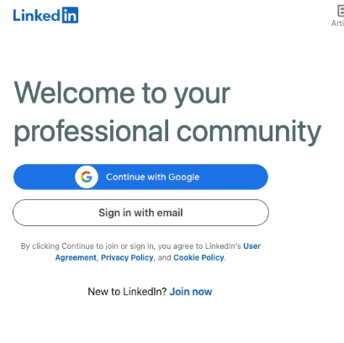
Why do we need to share resources securely?
Users don't want to Type or Enter the details details manually
Users don't want to remember/store the passwords for every website.
Resources like Users' First Name, Last Name, Email Address, Physical Address, Preferred Language can be shared easily without compromising security
Wall Street Journal
Eventbrite
ChatGPT Sign up
LinkedIn
Above images only for Sign up, Mostly user share sharing name and email etc.
But OAuth can be used to share the images/files/etc as well.

Slide 12
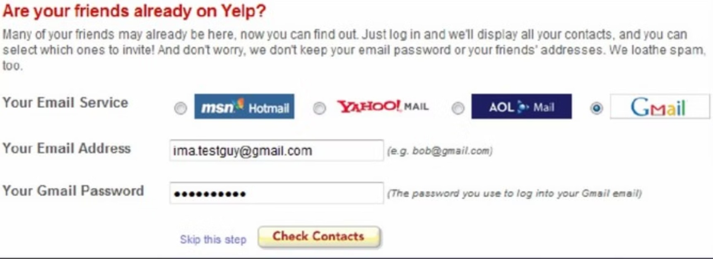
OK. OAuth Solved it. What we did before OAuth?
Ref: https://speakerdeck.com/nbarbettini/oauth-and-openid-connect-in-plain-english?slide=5
It's not a good idea to share your passwords with some random registration page

Slide 13
How OAuth works?
You have an account with Google, Facebook, Apple or any company you trust

Slide 14
How OAuth works?
You have already an account with Google, Facebook, Apple or any company you trust
Some registration page ask you to Sign Up with OAuth Links as an option (as shown above)

Slide 15
How OAuth works?
You have already an account with Google, Facebook, Apple or SaaS or any company you trust
Some registration page ask you to Sign Up with OAuth Links as an option (as shown above)
Once you logged into anyone of the Google/Facebook/Apple accounts and agree to share the data to New website, then only OAuth Servers share the data.

Slide 16
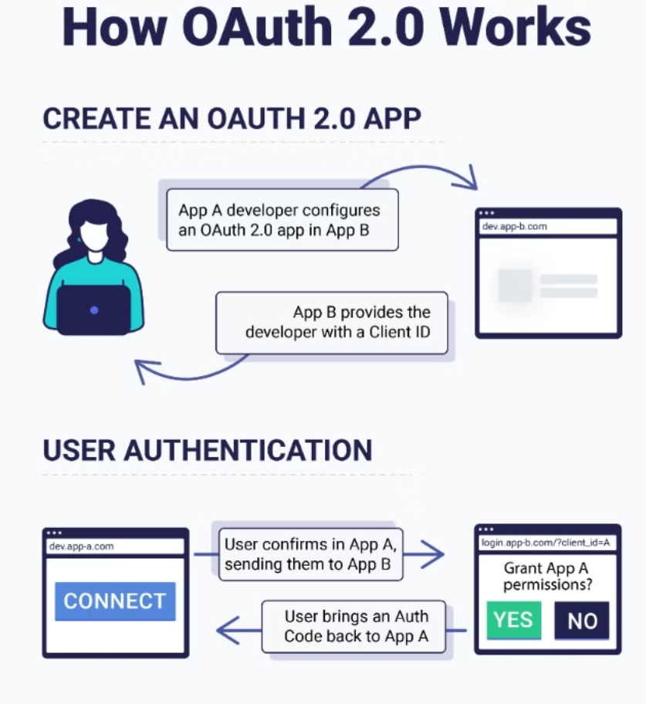
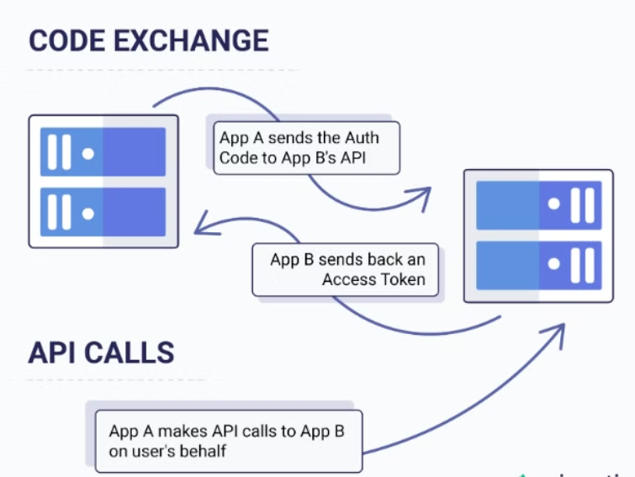
OAuth Flow at High Level
Ref: https://prismatic.io/docs/getting-started/oauth2/what-is-oauth2/

Slide 17
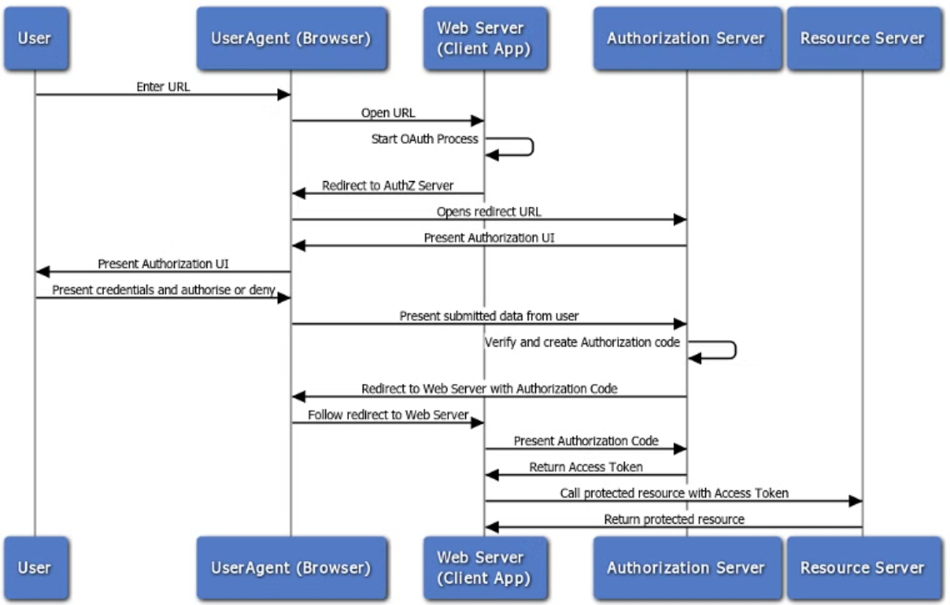
OAuth Flow
API Gateway OAuth 2.0 Authentication Flows

Slide 18
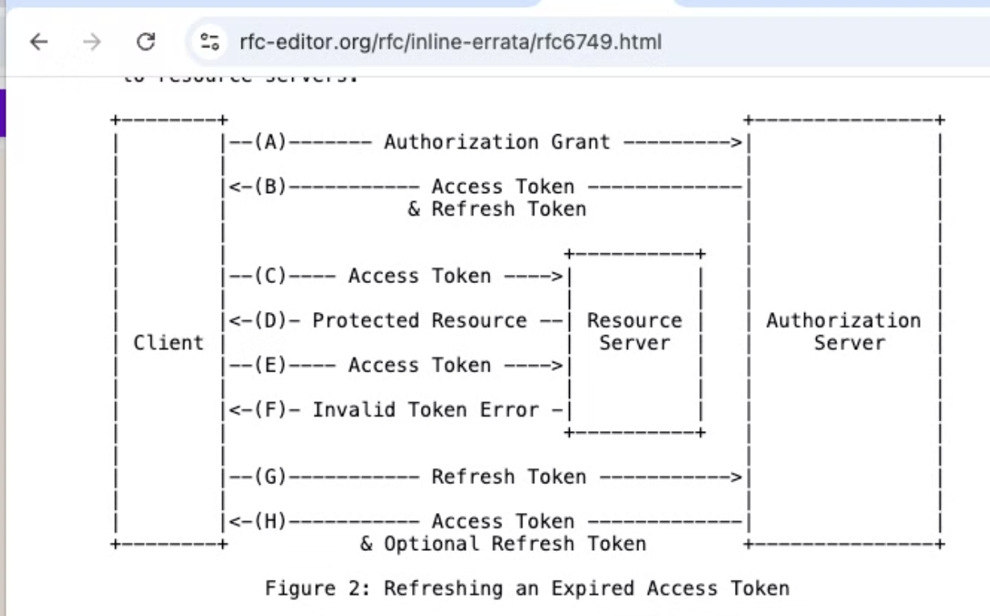
Refreshing Access Token with Refresh Token
rfc6749

Slide 19
OAuth Terminology
Resource Owner : User
Resource Server : The server that contains users information
Authorization Server : Handles the user data and interactions with 3rd party app
Client : 3rd Party app which is requesting access or we are registering now
client_id : 3rd party app
client_secret : it's a secret
Access Token and Refresh Token
Authorization Code : Intermediate to get the tokens
Sample OAuth Request
https://authorization-server.com/authorize?
response_type=code
&client_id=4SDzdxh-nbx0eq7fBK0jh8-w
&redirect_uri=https://www.oauth.com/playground/authorization-code.html
&scope=photo+offline_access
&state=PVPrz3naUgOsmFxz

Slide 20
OAuth Code Flows
Authorization Code Flow
The Authorization Code flow is suitable for server-side applications, utilizing an intermediary authorization server to exchange a code for an access token.
Client Credentials Flow
The Client Credentials flow is used for machine-to-machine authentication, without user involvement.
Authorization Code Flow with PKCE (Proof Key for Code Exchange)
Native mobile apps, single-page applications (SPAs), or other clients that can’t keep secrets.
Protect against Authorization Code Injection attacks.
Implicit Flow (Insecure/deprecated)
The Implicit flow, designed for client-side applications, directly returns an access token, introducing unique risks.

Slide 21
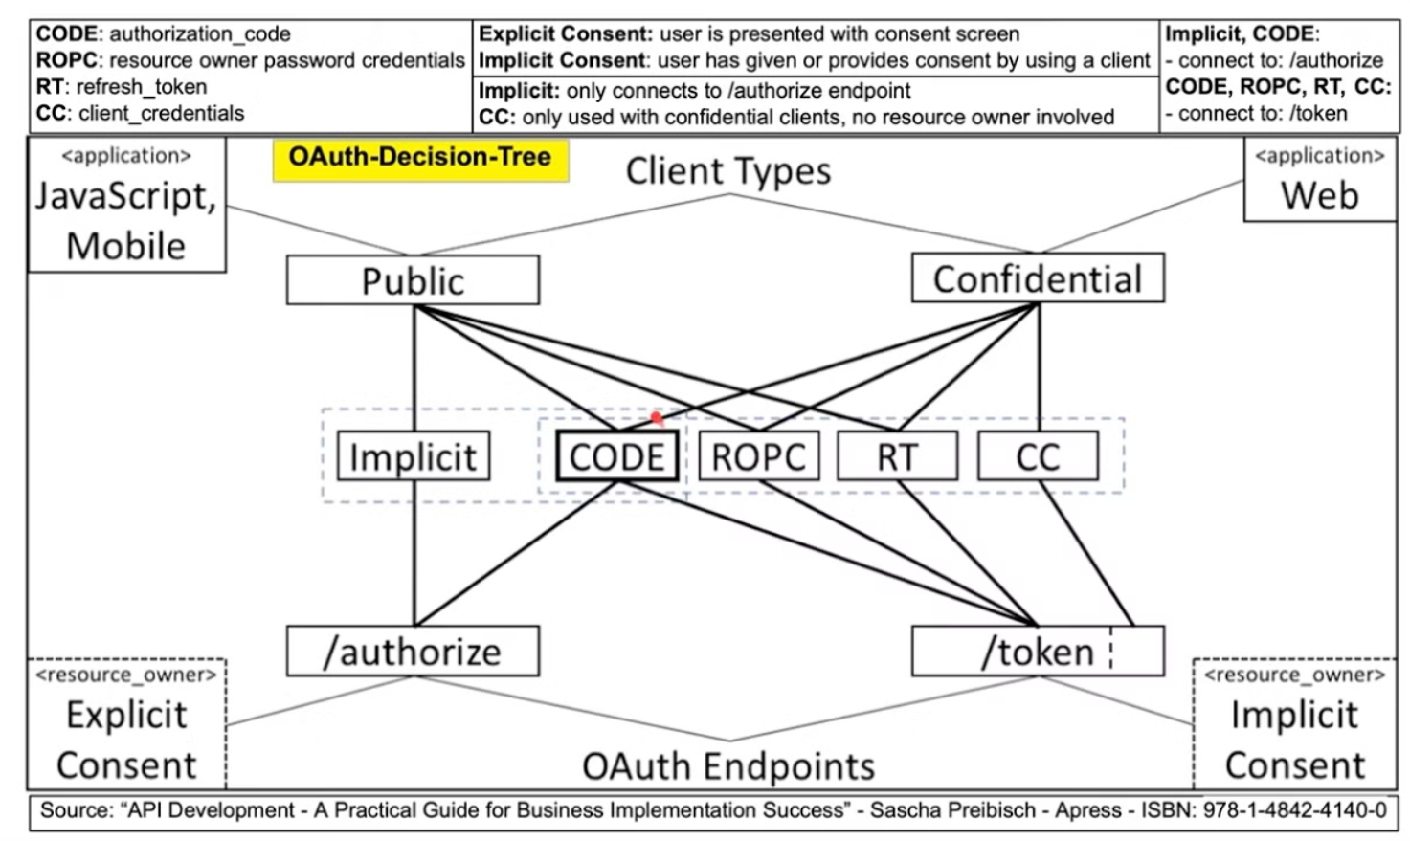
OAuth Flows

Slide 22

OAuth Playground
Demo Website: https://www.oauth.com/playground/index.html
OAuth 2.0 Security Best Current Practice

Slide 23
OAuth Reqeusts
https://authorization-server.com/authorize?
response_type=code
&client_id=4SDzdxh-nbx0eq7fBK0jh8-w
&redirect_uri=https://www.oauth.com/playground/authorization-code.html
&scope=photo+offline_access
&state=PVPrz3naUgOsmFxz
Take a close look at the request, You can guess few possible attacks

Slide 24

Common OAuth Vulnerabilities
Misconfigurations in Redirect URIs
Broken Authorization Grants
Attackers can exploit flaws in redirect URI configurations to gain unauthorized access to sensitive user data, impersonate legitimate users, or even escalate privileges within the system.
Vulnerabilities in the way authorization grants are handled can lead to account takeovers and data breaches.
Weak Client Authentication
Inadequate client authentication can allow attackers to masquerade as legitimate applications and gain unauthorized access to protected resources.

Slide 25
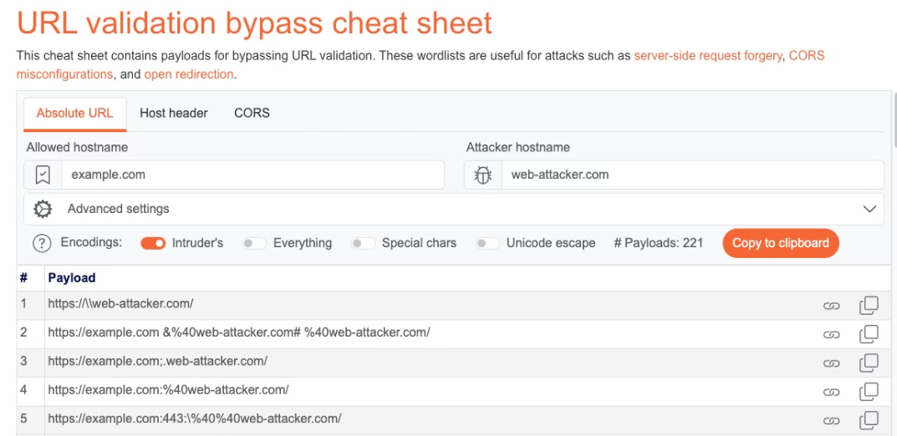
Redirect URI Misconfigurations
No Open Redirects
Careful validation and allowlisting of redirect URIs is critical to prevent such attacks.
Compare client redirect URIs against the pre-registered URIs with Exact String Match
Misconfigurations:
https://*.somesite.example/* —> https://attacker.example/.somesite.example
target.com.attacker.com
Double submit redirect_uri.
https://default-host.com &@foo.evil-user.net#@bar.evil-user.net/
Portswigger has URL Validation bypass cheat sheet:
URL validation bypass cheat sheet for SSRF/CORS/Redirect - 2024 Edition | Web Security Academy
Lab: OAuth account hijacking via redirect_uri | Web Security Academy
https://www.acsac.org/2023/files/web/slides/innocenti-97-oauthvalidation.pdf

Slide 26
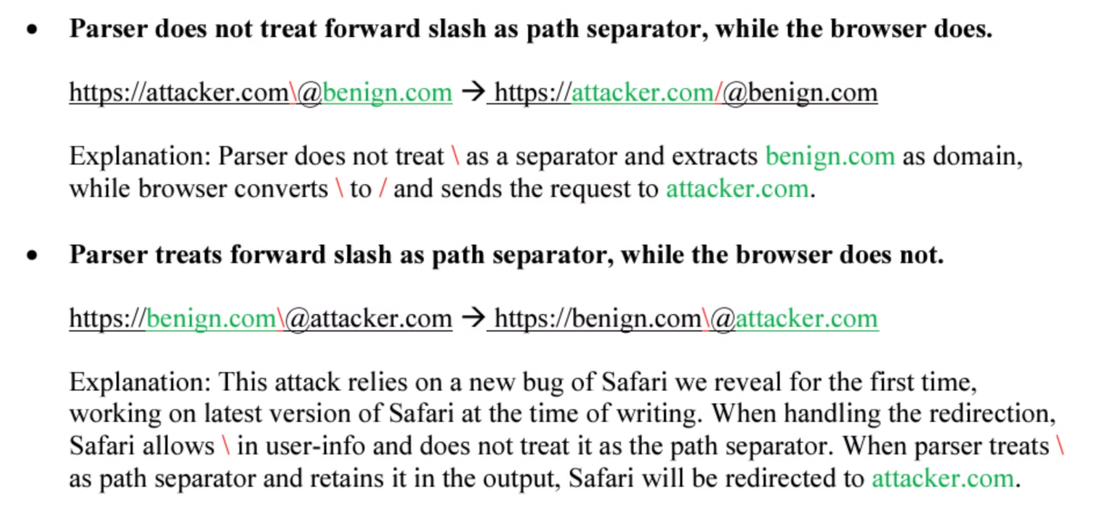
Redirect URI Misconfigurations
Due to Parser validations
Lab: OAuth account hijacking via redirect_uri | Web Security Academy
https://www.acsac.org/2023/files/web/slides/innocenti-97-oauthvalidation.pdf
https://i.blackhat.com/asia-19/Fri-March-29/bh-asia-Wang-Make-Redirection-Evil-Again-wp.pdf

Slide 27
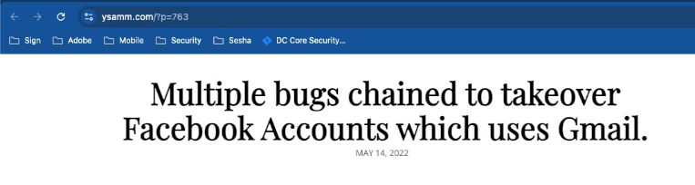
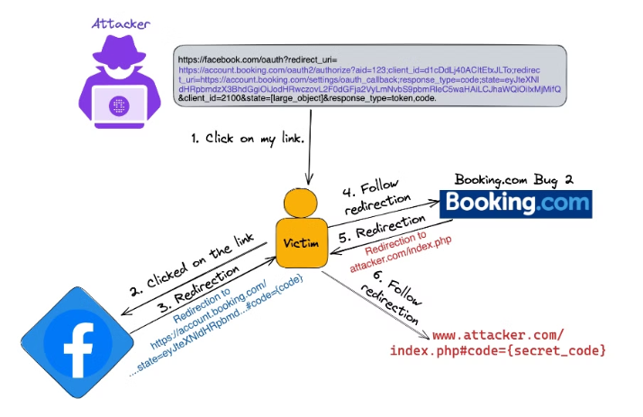
Redirect URI Misconfigurations examples
Redirect URI + XSS/Open Redirection/HTML Injection —> Account takeover
OAuth Account Takeover - Account Takeover on Booking.com
Multiple bugs chained to takeover Facebook Accounts which uses Gmail.

Slide 28
OAuth Authorization Grant Vulnerabilities
OAuth Authorization Grants (e.g., Authorization Code, Implicit Flow) are vulnerable to exploitation.
Improper implementation can allow attackers to bypass the authorization process.
Weakness in Grant Validation Logic:
Failure to validate key parameters like state can lead to unauthorized access.
Flaws in token exchange mechanisms can allow attackers to obtain valid tokens without user consent.

Slide 29
Attacking Weak Client Authentication
Exploiting Hardcoded Secrets
Mitigating Weak Authentication
Weak Client Authentication: Many OAuth implementations use inadequate client authentication methods, allowing attackers to impersonate legitimate clients and gain unauthorized access to sensitive data.
Enforce Strong Client Authentication: Use cryptographic keys instead of client secrets, rotate secrets regularly, and ensure credentials are securely stored, such as in a secure vault.
Access Control and Monitoring: Implement strict access control measures and actively monitor access logs to detect and respond to unauthorized client access attempts.
Insecure Secret Storage: Hardcoding client secrets in application code or storing them insecurely makes it easy for attackers to retrieve and misuse these secrets to authenticate as valid clients.
Use OAuth Best Practices: Follow OAuth security guidelines, including using PKCE (Proof Key for Code Exchange) for public clients and restricting access scopes to minimize exposure.

Slide 30

Discovering and Leveraging Insecure Token Storage
Improper Token Storage: Storing access or refresh tokens in plain text or without encryption can expose them to attackers, leading to unauthorized access.
Token Rotation & Revocation Risks: Failing to rotate or revoke refresh tokens could allow attackers to maintain persistent access even if a token is compromised.
Security Best Practices: Tokens must be encrypted at rest, rotated regularly, and revoked promptly when sessions end or accounts are deactivated.

Slide 31

Mitigating OAuth Risks: Best Practices
Enforce Strict Redirect URI Validation: Ensure all redirect URIs are allowlisted and properly sanitized to prevent hijacking. This minimizes the risk of redirect-based attacks.
Strengthen Client Authentication: Use cryptographic keys instead of client secrets when possible, rotate credentials regularly, and store them securely (e.g., using a secure vault).
Robust Authorization Grant Validation: Verify the integrity of the state parameters to prevent CSRF attacks and validate token exchanges to ensure requests come from legitimate sources.
Secure Token Storage and Handling: Use encrypted storage for tokens, enforce regular rotation and prompt revocation when tokens are no longer needed, and avoid storing tokens in accessible client storage (e.g., in localStorage for JavaScript).

Slide 32
RFC Security Best Practices
4. Attacks and Mitigations
4.1. Insufficient Redirect URI Validation
4.2. Credential Leakage via Referer Headers
4.3. Credential Leakage via Browser History
4.4. Mix-Up Attacks
4.5. Authorization Code Injection
4.6. Access Token Injection
4.7. Cross-Site Request Forgery
4.8. PKCE Downgrade Attack
4.9. Access Token Leakage at the Resource Server
4.10. Misuse of Stolen Access Tokens
4.11. Open Redirection
4.12. 307 Redirect
4.13. TLS Terminating Reverse Proxies
4.14. Refresh Token Protection
4.15. Client Impersonating Resource Owner
4.16. Clickjacking
4.17. Attacks on In-Browser Communication Flows

Slide 33
References
RFC 6749: The OAuth 2.0 Authorization Framework
OAuth 2.0 — OAuth
OAuth 2.0 Playground
OAuth 2.0 authentication vulnerabilities | Web Security Academy
OAuth2 - OWASP Cheat Sheet Series
OAuth 2.0 and OpenID Connect (in plain English)

Slide 34
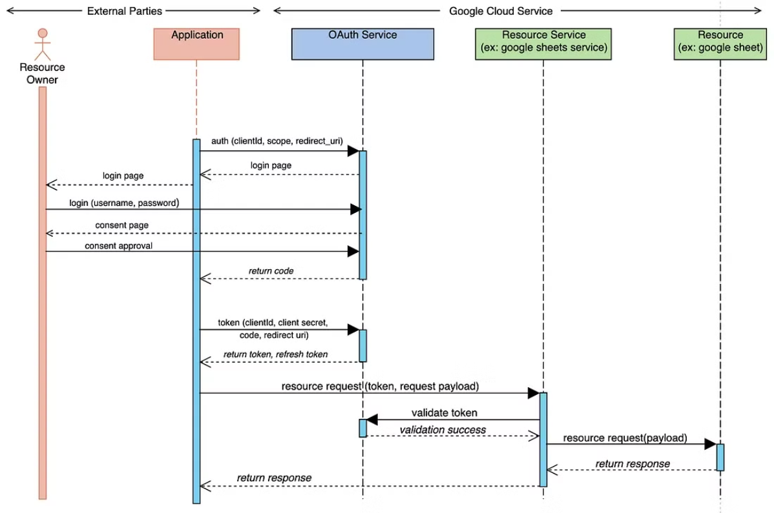
Google OAuth Flow
Google Oauth2 API Explained

Slide 35
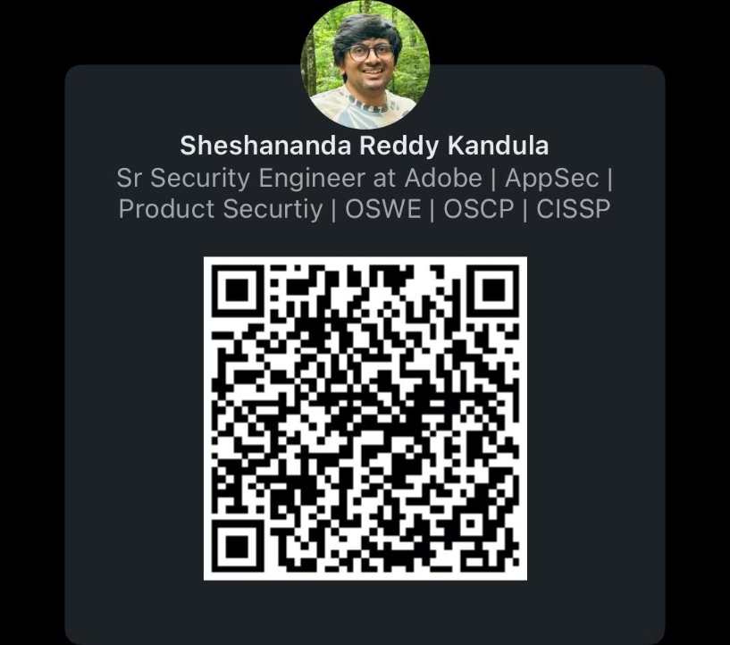
Thank You

